Slide 1
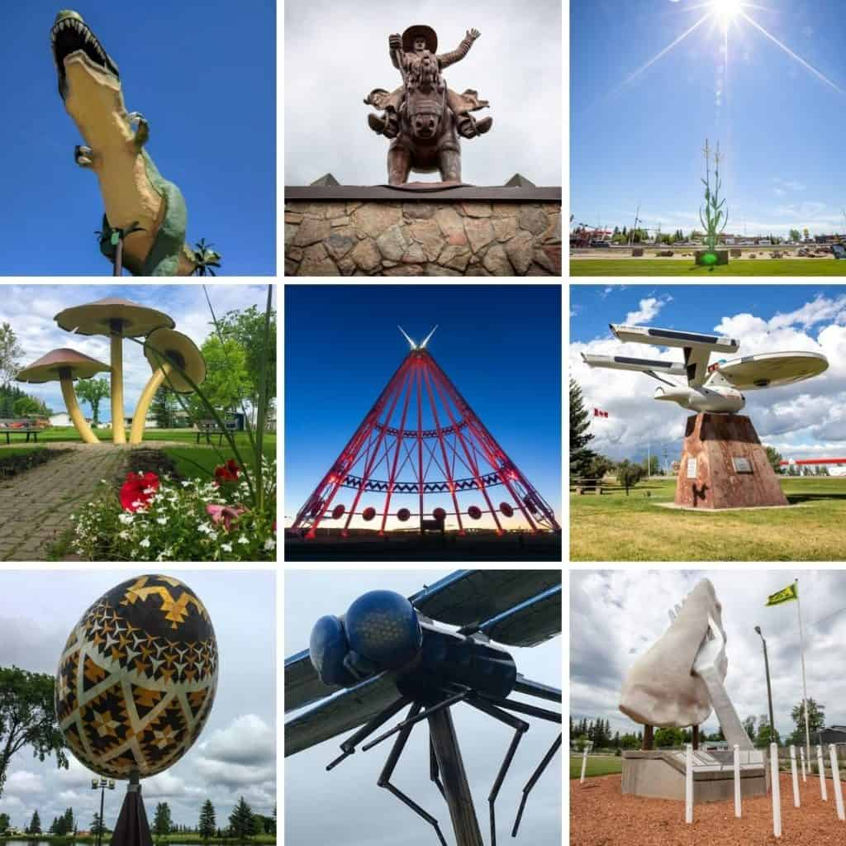
Alberta Discovery Tour 2025
IMRG 1908 Passport

Slide 2
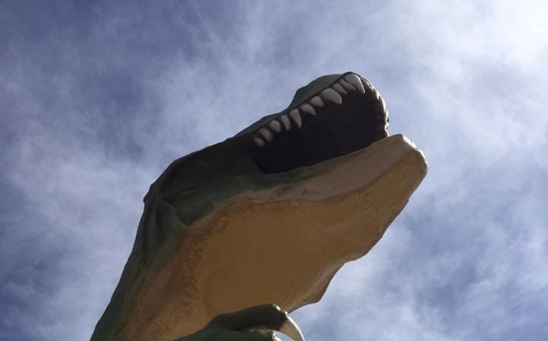
How to play: 1) During the 2025 riding season, explore Alberta and visit each of the listed road side attractions. 2) For proof of visit, take a picture of the attraction with your motorcycle or yourself in riding gear along attraction. 3)The addresses are approximate, If you cannot find it , seek guidance from a local. 4) Save the Power point file to your computer and add the picture to the appropriate slide. 5) To add pictures to the PP, save them in a folder. Then on the slide, click on the circled icon, Pick the folder where the photo is located and then click the picture to add. Also, a photo can be dragged from folder to the photo box in slide on power point.
IMRG 1908 Passport 2025

Slide 3
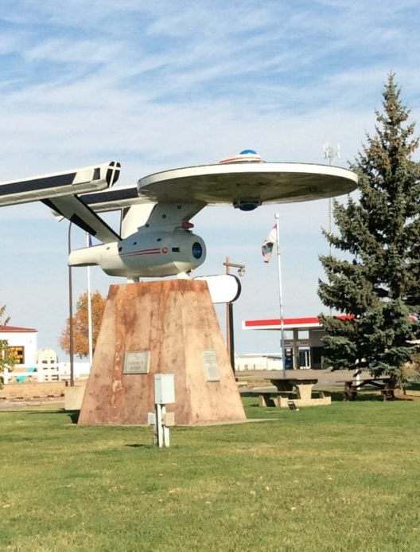
How to play continued: 6) Update the tracking slide #4 so you can track your progress. 7) At the end of the season, we will ask for your passport to be emailed back. 8) The top 3 explorers will be presented prizes at the year-end BBQ
IMRG 1908 Passport 2025

Slide 4
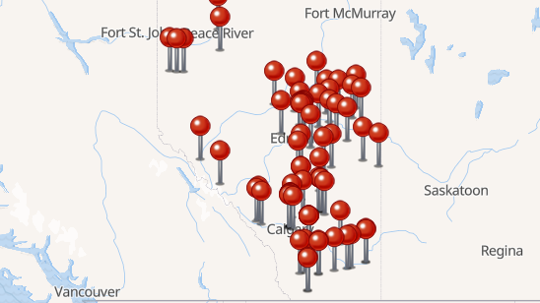
Alberta Discovery Tour 2025
Attractions Visited
XX / 66
Update above number when a picture is added

Slide 5
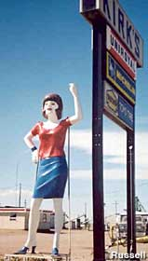
Uniroyal Gal 5705 64 St, Taber, AB
Add Photo Below
Known as "Kirk's Tire Woman" in her previous life, she's found a new home in a new town.

Slide 6
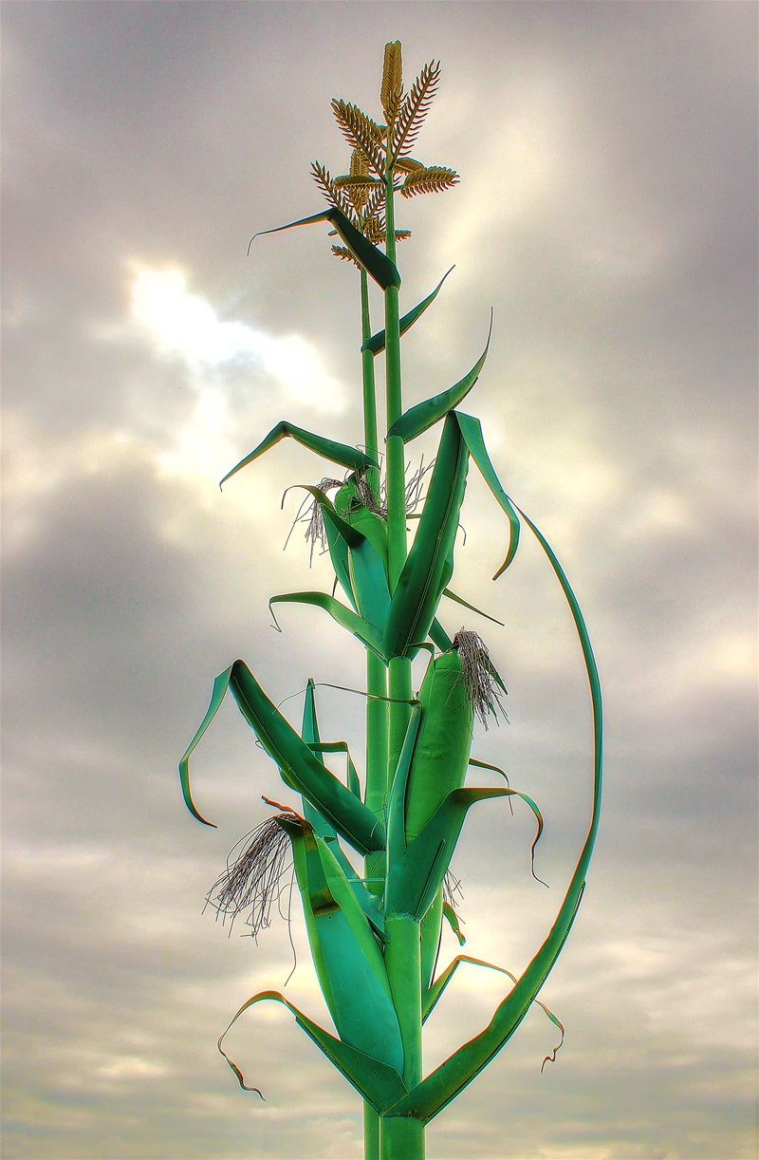
Giant Corn Stock - 4712 50 St, Taber, AB
Built in 1994 this 36 foot tall corn stalk is a symbol of the famous Taber Corn. It represents the quality, taste and success of Taber Corn throughout Western Canada.
Add Photo Below

Slide 7
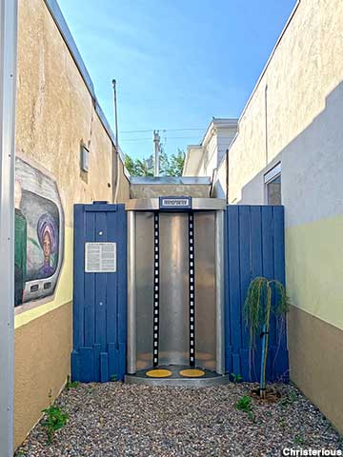
Star Trek Transporter - 225 Centre St., Vulcan, Alberta
A two-person Star Trek transporter, set into the short alley next to a downtown building, is an irresistible photo-op temptation for Trekkies.
Add Photo Below

Slide 8
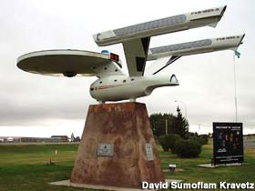
Starship Enterprise - Service Rd, Vulcan, Alberta
A large, impressive replica of the original series Enterprise with its own unique service number. A plaque on the ship -- in English, Vulcan, and Klingon -- explains why it's here.
Add Photo Below

Slide 9
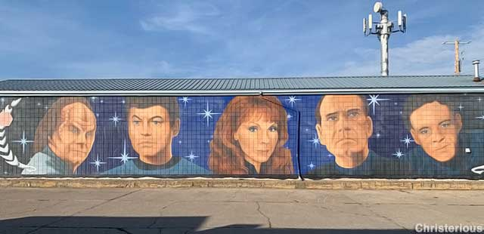
Star Trek Doctors Mural - 220 Centre St., Vulcan, Alberta,
The faces of the Star Fleet doctors from various Star Trek TV series diagnose you from one large outdoor mural.
Add Photo Below

Slide 10
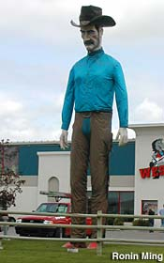
Giant Cowboy Statue - 61 E. Lake Ave., Airdrie, Alberta
Towering westerner, perhaps 30 feet tall, with a big hat and mustache. Fabric attire. May have been built by Bob Prewitt Fiberglass in the 1960s.
Add Photo Below

Slide 11
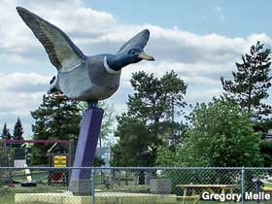
World's Largest Mallard Duck - Highway 45, Andrew, Alberta,
Reproduced in flight with a 23 ft. wingspan, on an angled metal support, like a jet fighter would be in the U.S. The majestic duck was erected in 1992 as a commemorative honk to duck breeding grounds in the local wetlands
Add Photo Below

Slide 12
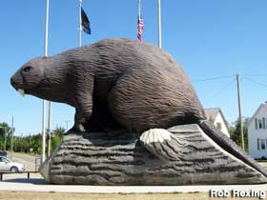
World's Largest Beaver - 5 Ave., Beaverlodge, Alberta
Canada's mightiest tree-biter is 15 feet high, 18 feet long, and sits atop a 20-foot-long log. Built in 2004 for the town's 75th birthday. Officially named "Justin Beaver" in 2022.
Add Photo Below

Slide 13
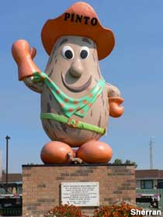
Pinto McBean Statue - Hwy 3, Bow Island, Alberta
They sure love their pinto beans in Bow Island. The fiberglass bean in cowboy duds is their official mascot.
Add Photo Below

Slide 14
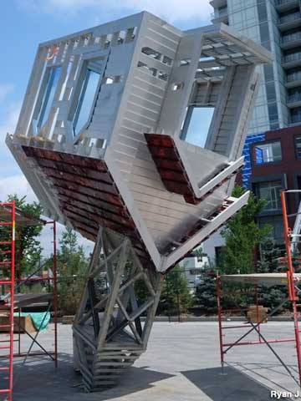
Upside Down Church - 750 5th St. SE, Calgary, Alberta
Officially titled "Device to Root Out Evil" by artist Dennis Oppenheim, it's a small, half-built church balanced upside down on its steeple. Originally in Vancouver in 1997, where it confused people so it ended up here. Taken down in 2014, put back up in 2019..
Add Photo Below

Slide 15
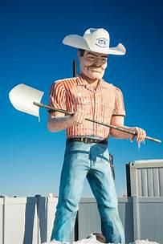
Cowboy Muffler Man - 9424 60 St. SE, Calgary, Alberta
This is a retired Phillips 66 Cowboy Muffler Man that has been hidden in Calgary for 15 years. In the late 1960s the owner of a mobile home business in Edmonton purchased the cowboy from a Phillips 66 station in the U.S. and moved him to Canada. It stood for many years at the mobile home business until it closed around 1999. The cowboy was then moved to the owner's farm -- until the farm was purchased by the Muffler Man's current owner. He had the cowboy restored and moved him to his business in Calgary where he has stood ever since.
Add Photo Below

Slide 16
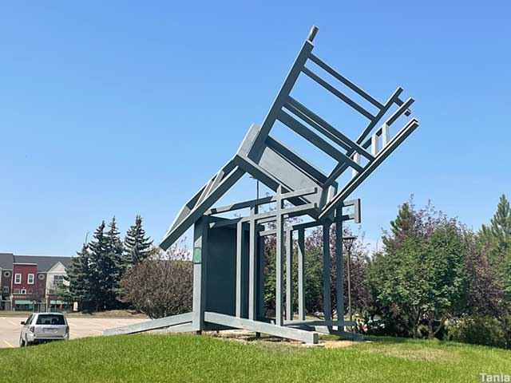
Two Giant Chairs in a Pile - Mt. Royal Circle SW, Calgary, Alberta
"Homage" by Derek Michael Besant is two 20-foot-tall steel chairs, one on its side, the other balanced on top upside-down
Add Photo Below

Slide 17
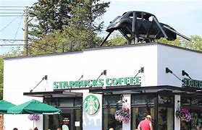
Spider Beetle - 2509 14 St. SW, Calgary, Alberta
1968 Volkswagen on six legs, so perhaps more bug than spider. Built in 1986.
Add Photo Below

Slide 18
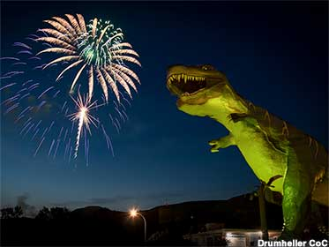
Tyra: World's Largest Dinosaur - 60 1 Ave W., Drumheller, Alberta
This 82 foot beast was a year 2000 project for the Drumheller Regional Chamber of Development & Tourism in Alberta. It's 82 feet high and 151 feet long
Add Photo Below

Slide 19
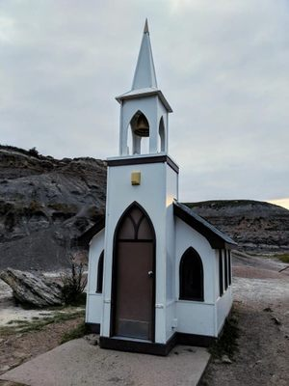
Drumheller's Little Church - N. Dinosaur Trail, Drumheller
According to a local saying, this small church in the badlands of Alberta seats 10,000 people, six at a time. It was originally constructed in 1968 and then rebuilt by people incarcerated in Drumheller Institution, a nearby federal penitentiary, in 1991. The Little Church has a pulpit and six single-person pews.
Add Photo Below

Slide 20
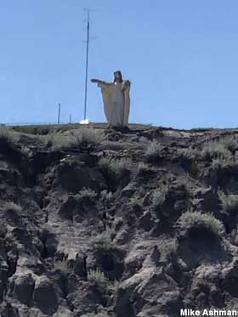
30-Foot-Tall Jesus of the Dinosaurs - 2 Premier Way, Drumheller, Alberta
Built decades ago by Tig Seland as part of his Christian-flavored Prehistoric Park attraction. The park closed and its dinosaurs were dispersed. Jesus remains. The statue of Jesus is up in the hills. He blends well into the hillside and is a little bit hard to find.
Add Photo Below

Slide 21
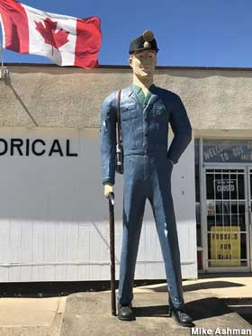
Towering Miner, Quirky Museum - 335 1st St E, Drumheller, Alberta
Mine worker with pick ax and helmet stands about 14 ft. tall next to the building entrance and dinosaur mural. The Centre museum promises quirky sights inside.
Add Photo Below

Slide 22
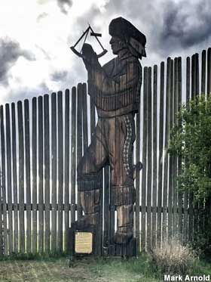
Giant Wooden Statue of Peter Fidler - Hwy 41, Elk Point, Alberta,
An unusual 2-D statue, carved with a chainsaw from wood beams, stands 32 feet tall in front of an equally-oversized stockade fence. Peter Fidler was a surveyor who mapped much of western Canada.
Add Photo Below

Slide 23
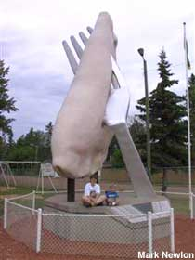
World's Largest Pyrogy - Hwy 28, Glendon, Alberta
A blobby white thing on a big fork. Fiberglass with metal frame, 27 feet high, built in 1991. Glendon calls itself the Perogy Capital of the World and has an annual Perogy Festival.
Add Photo Below

Slide 24
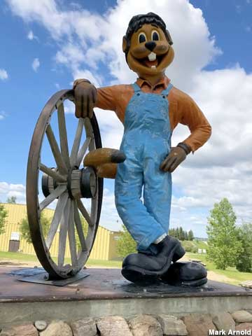
Clem T. GoFur - Gopher Mascot 1st Ave., Torrington, Alberta
On his stone pedestal, this bib-overall-wearing cartoon mascot stands about 12 feet tall. Erected in 1991, Clem T. GoFur's popularity spurred the creation of the town's famous Gopher Hole Museum in 1995.
Torrington was aghast in 2013 when Clem was found toppled from his pedestal, the victim of what the town called "inherent design flaws" and possibly some gopher-hating fiend giving Clem a hard push. The smiling fiberglass rodent was rebuilt, repaired, and reattached with enhanced nudge-proof anchoring in 2015.
Add Photo Below

Slide 25
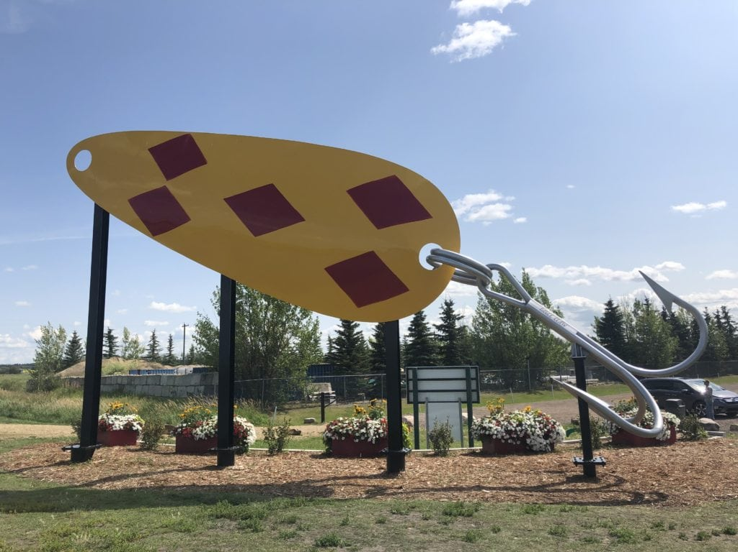
World's Largest Fishing Lure - Len Thompson Drive, Lacombe, Alberta
this 40-foot fishing lure was installed in May of 2019 and recently accepted into the Guinness Book of World Records.
Add Photo Below

Slide 26
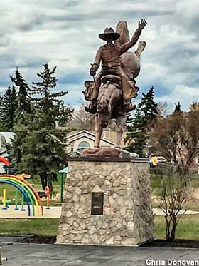
Bucking Bronco and Rider Statue - Ponoka, Alberta
2004 bronze sculpture for town's centennial, "The Legacy" rodeo cowboy on a bronc horse. Claims "World's Largest" status. Sculpture is 21 ft. tall, 32 ft total with base.
Lion's Centennial Park.
Add Photo Below

Slide 27
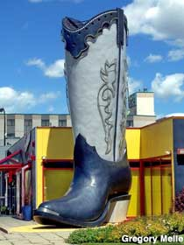
Giant Cowboy Boot - 10007 167 St. NW, Edmonton, Alberta
Forty feet tall, the last remnant of a boot factory that went boots up.
Add Photo Below

Slide 28
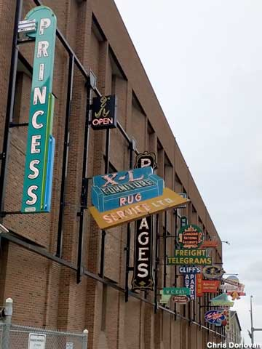
Outdoor Neon Sign Museum - 10303-10323 104 Ave NW, Edmonton, Alberta
Edmonton's beloved neon is being restored and installed along half a city block, lit at night. Col. Mustards Canteen, Canadian Furniture, Mikes News and Smokes...currently over 20 signs.
Add Photo Below

Slide 29
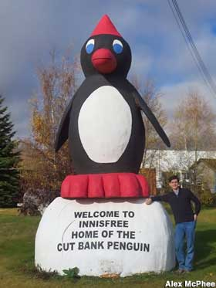
Ernie the Cut Bank Penguin - Railway Ave., Innisfree, Alberta
A downsized reproduction of the 27-foot-tall penguin statue in Cut Bank, Montana. Built by a Hollywood crew for the film, "Cut Bank," which was filmed here in 2013.
Add Photo Below

Slide 30
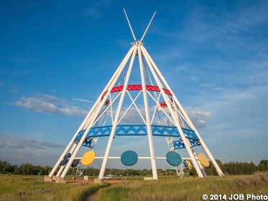
World's Largest Tee Pee - Allen Roe Rd SE, Medicine Hat, Alberta
An airy interpretation of a traditional teepee, 215 feet tall. Built for the 1988 Calgary Winter Olympic Games and moved here three years later.
Add Photo Below

Slide 31
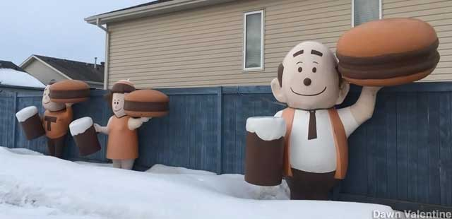
A&W Burger Family - 10604 100 Ave., Morinville, Alberta
Three-fourths of the classic Burger Family -- Papa, Mama, and Teen -- at the A&W drive-through in Morinville.
Add Photo Below

Slide 32
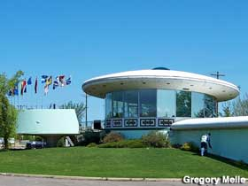
World's First UFO Landing Pad - Hwy 29, St. Paul, Alberta
Built in 1967 with the blessings of the town. St. Paul has been waiting for the aliens ever since. UFO exhibit and space alien photo op cutouts.
Add Photo Below

Slide 33
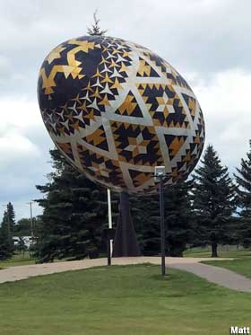
World's Largest Easter Egg: The Pysanka - 4500 Pysanka Ave, Vegreville, Alberta
The "Pysanka" -- the Ukrainian word for Easter Egg -- also spins like a weather vane. 27.5 feet long, 31 feet high, made of aluminum, and created in 1975 by college professor Ronald Resch. Visited by Queen Elizabeth in 1978.
Add Photo Below

Slide 34
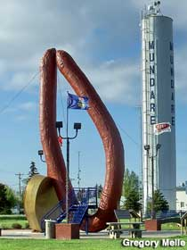
World's Largest Sausage - Sawchuk St. Mundare, Alberta
An immense Ukrainian sausage, with an elevated posing platform for visitors. 42 feet high, it's the tallest piece of meat anywhere in the world.
Add Photo Below

Slide 35
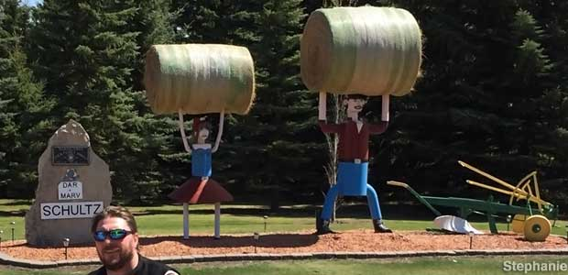
Superhuman Hay Stackers - 49111 Hwy 21, Hay Lakes, Alberta
Farmers Dar and Marv Schultz sculpted larger-than-life versions of themselves out of farm equipment, hoisting huge hay bales over their heads.
Add Photo Below

Slide 36
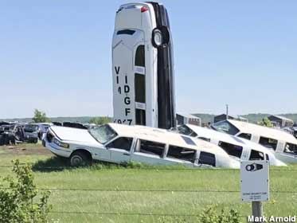
Limohenge: a Lincoln Memorial - Twship Rd 553, Lamont, Alberta
Limohenge is the creation of Lamont junkyard owner Terry Carter. In a 2013 interview with Edmonton CTV News, Carter said that the three limousines buried at an angle depict three stages in a car crash (each has a different degree of collision damage), while the black and white limos buried upright are "good versus evil." Although the cars have been subsequently dubbed Limohenge by the public, in 2013 Terry called the arrangement the "Lincoln Memorial," because all of the limousines are Lincolns.
Add Photo Below

Slide 37
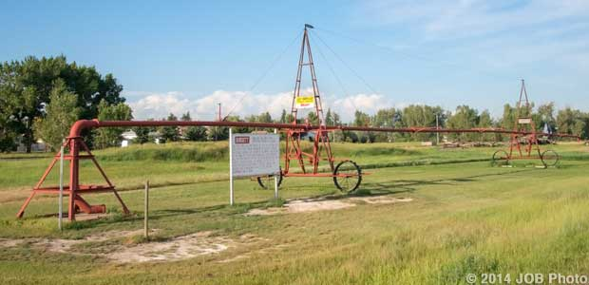
First Pivot Irrigation System in Canada - Main St., Burdett, Alberta
The first pivot irrigation system was introduced to Canada by Donald and Wyman Campbell, who moved to the area from Nebraska during 1962. The system was in operation by May 1962 and was used continuously for 25 years.
Add Photo Below

Slide 38
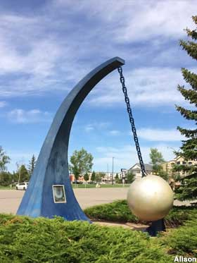
World's Largest Wind Gauge - 2805 Scenic Drive S., Lethbridge, Alberta
In a region of powerful prairie winds, this photo op sculpture claims to be the World's Largest Wind Gauge, although it doesn't actually work. It was originally designed to be a working wind gauge, but the strong winds in the area raised concerns that it might whip the giant ball around and hurt someone, so it was welded in place.
Add Photo Below

Slide 39
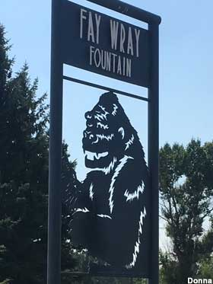
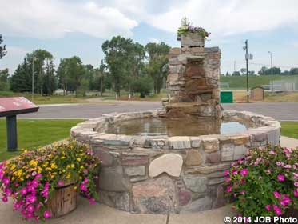
Fay Wray King Kong Fountain - Main Street, Cardston, Alberta
Hollywood actress Fay Wray's home town remembers her with a fountain and a metal cutout that incorporates a tiny Fay and a big King Kong.
Add Photo Below

Slide 40
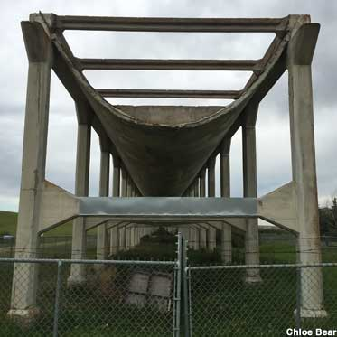
Aqueduct - Giant Centipede of the Prairie - Range Road 142, Tilley, Alberta
Called River in the Sky. It even had fish. Built by Canadian Pacific Railway in 1912-1914 to turn rangeland into farmland. It was 31 km long reinforced concrete carrying water from the Bow River. The main engineering innovation was an inverted siphon to run the water under the CPR mainline as the aqueduct wasn't high enough for the trains to get under. It never operated efficiently and was replaced by 1979 by the present day canal, alongside, which also goes under the CPR mainline.
Add Photo Below

Slide 41
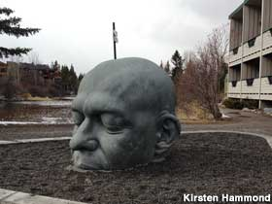
The Big Head - Main St., Canmore, Alberta
The town of Canmore gets its name from the Gaelic "big head," so artist Al Henderson created a literal translation: a bald man's head emerging from the ground. It's a Big Head.
Add Photo Below

Slide 42
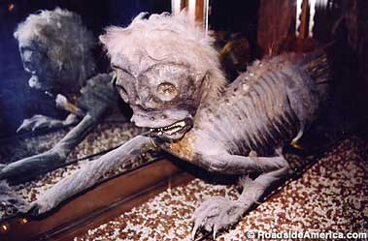
Merman - Indian Trading Post - 101 Cave Avenue, Banff, Alberta. Located in Building. Take selfie
The Banff Merman, with its grotesque mix of mammalian and aquatic features, is one of the few mummified mermaids (or mermen) found around the world. Its origin remains a mystery, and its age is unknown, adding to the allure and intrigue of this maritime oddity
Add Photo Below

Slide 43
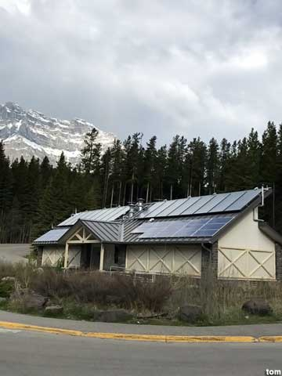
$2 Million Outhouse - Lake Minnewanka Scenic Drive, Banff, Alberta
Banff National Park's lavish "biffy" is an unusual tourist attraction, not just for its funky EcoArt and green technology, but because it will take 576 years to pay itself off.
Add Photo Below

Slide 44
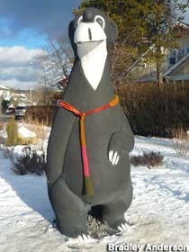
Jasper The Bear Statue - Patricia Street, Jasper, Alberta
Jasper the Bear is located on the 400 block of Patricia Street in Jasper, Alberta. The statue has been at its current location since 2004. The original Jasper the Bear statue was at the train station but was removed after it had been vandalized.
Add Photo Below

Slide 45
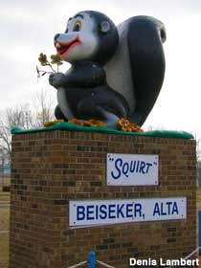
Squirt the Skunk - 485 4 Ave., Beiseker, Alberta
A lovable cartoony mascot, bigger than a real skunk, with a bucktooth smile and a paw full of wildflowers. The slogan that justified its creation was, "It makes scents to stop in Beiseker." 13-ft. tall.
Add Photo Below

Slide 46
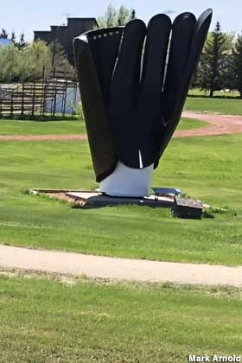
Canada's Largest Baseball Glove - 300-302 Lougheed Ave, Heisler, Alberta
Even though the town of Heisler's logo is a German guy in lederhosen hoisting a beer mug, the town itself is proudest of its love of American baseball. So in June 2007 a local artist built Canada's Largest Baseball Glove next to the town's baseball diamond. The glove is 13.5 feet high, 7.5 feet wide, and designed so that people can sit in it for gag photos.
Add Photo Below

Slide 47
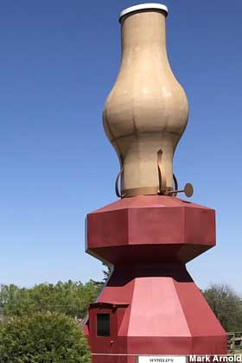
World's Largest Oil Lamp - Railway Ave., Donalda, Alberta
Opened on July 1, 2000, the lamp stands 42 feet tall and lights up at dusk. It took four years to build. You can walk around inside its base and admire the historical murals, then walk across Main Street to the Donald and District Museum, which displays one of the world's largest collections of kerosene oil lamps, currently numbering over 900.
Add Photo Below

Slide 48
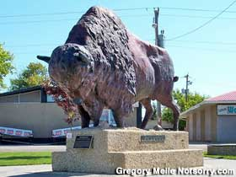
Big Canadian Buffalo - 1303 - 10th Street, Wainwright, Alberta
The fiberglass statue is ten feet tall. Wainwright was once the site of Canada's biggest buffalo herd.
Add Photo Below

Slide 49
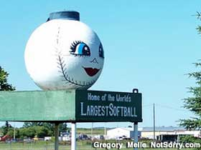
Suzie: World's Largest Softball - 5th Avenue, Chauvin, Alberta
Six feet across? Maybe not quite. Appears to have been built from an old fiberglass tank. Here since 1970, painted with a cartoon woman's face, and named Suzie.
Add Photo Below

Slide 50
World's Largest Mushrooms - 49th St., Vilna, Alberta
A clump of giant metal mushrooms stand in a public park, more for decoration than kid climbing. Cost to build was $35K and stand over 20 feet tall.
Add Photo Below

Slide 51
Large Pumpkins - 246 W. Railway Drive, Smoky Lake, Alberta
Five giant naturally-misshapen painted concrete pumpkins lined-up as a photo-op. The town is known for its annual Pumpkin Fair and Weigh-Off.
Add Photo Below

Slide 52
Largest Dragonfly in Canada - Range Rd 40B, Wabamun, Alberta
Made from aircraft wings, a light pole, and propane tanks, the nearly 10m Giant Dragonfly at the entrance to Wabamun is a sight to behold. It has been beautifully painted and is mounted high in the sky facing north.
Add Photo Below

Slide 53
World's Largest Wagon Wheel and Pick Axe - Main St., Fort Assiniboine, Alberta
Unveiled in 2005, and both are of Bunyanesque proportion: the wheel has a 24 ft. diameter and the axe is 24 ft. tall.
Add Photo Below

Slide 54
World's Largest Honey Bee - 3 Ave. SE, Falher, Alberta
The "Honey Capital of Canada" is surrounded by clover fields and bees. The giant bee statue was built in 1990 by Richard Ethier, a local welder. It's perched atop a 20-foot-high pole and is 23 feet long.
Add Photo Below

Slide 55
12 Foot Davis - 100 Ave., Peace River, Albert
12 Foot Davis earned his fortune (and nickname) by claiming a 12-foot-wide strip of land during the Cariboo Gold Rush. He later became an independent trader in the Peace River area. Despite his name he was of normal height, but that sure didn't stop the town of Peace River from putting up a 15.2-foot-tall wooden statue of the guy. His grave site (which was the former location of the statue) is further up the valley.
Add Photo Below

Slide 56
Millennium Sundial - 106 St, Grande Prairie, Alberta
Huge 40-ft tall metallic sundial, a public art project erected for the year 2000 celebration. This 197 diameter sundial is in Bud Miller All Season Park
Add Photo Below

Slide 57
Giant Cream Can – Markerville, Alberta
It is 15 feet tall and very heavy. It commemorates 100 years of Icelandic settlement and is an acknowledgement to the settlers who founded the district, developed a creamery and developed the agricultural land
Add Photo Below

Slide 58
Giant Northern Pike - Rochon Sands, Alberta
Some residents call the fish "Harvey", but officially the 8M Northern Pike does not have an official name. It is a wonderful monument that has such great detail and is life-like...it is a must-see!
Add Photo Below

Slide 59
Giant Crow Guarding their Nest – Blairmore, Alberta
Constructed in 1958, the sculpture is of a 12-foot-long crow perched atop a 20-foot-tall tree, with a baby crow in a nest on the opposite side. It was designed and created by local artist, Franz Josef Koci, when he was a student at the Alberta College of Art and Design in Calgary. The crows are made of concrete, each weighing about a ton. The structure is reinforced with steel railway rails running through the tree trunk
Add Photo Below

Slide 60
The Largest Pincher – 1037 Bev McLachlin Dr Pincher Creek, Alberta
While traveling through the area in 1868, a group of prospectors unfortunately lost an important tool in a creek These pincers were important, as they were used to trim the feet of horses and it was not something you wanted to lose while in the middle of nowhere. Six years later, a mounted police officer from Fort Macleod while on patrol happened to discover the rusting tool that the prospectors had lost. From there, Pincher Creek was the name given to the creek. In 1880, that name appeared on a Geological Survey Report.
Add Photo Below

Slide 61
Sammy and Samantha: Giant Potatoes – Vauxhall
Known as the "Potato Capital of the West," visitors are immediately greeted upon arrival to the Town of Vauxhall by this unique landmark. Sammy & Samantha Potato were built in 1993 to advertise Vauxhall as the Potato Capital of the West.
Add Photo Below

Slide 62
Giant Sunflower – Bow Island, Alberta
This giant sunflower was built as part of a contest. It is said it can withstand winds of over 100 km/h. It's 30 feet tall and it weighs a ton.
Add Photo Below

Slide 63
Okotoks Erratic – Hwy 7w Okotoks, Alberta
Visible from considerable distance across the relatively flat terrain of the prairie landscape, ‘Big Rock’ is an enormous glacial erratic. The 16,500-tonne rock was from a mountain range in Jasper National Park. It was transported far from its mountainous place of origin by a rockslide, then by a glacial sheet of ice between 10,000 to 30,000 years ago to its present-day location just west of the Town of Okotoks.
Add Photo Below

Slide 64
World’s Largest Black Diamond – 301 Centre Ave W, Diamond Valley, AB
The towns of Turner Valley and Black Diamond merged in 2023 to become Diamond Valley. The Black Diamond is located in front of the Black Diamond Municipal Offices on the south side of Hwy 22 and 2nd Street NW.
Add Photo Below

Slide 65
Centennial Clock Tower – 101 Railway Ave Oyen, Alberta
For its 100th birthday, Oyen celebrated by giving the town the perfect gift: a wristwatch. It stands where the train station and grain elevators once stood, memorializing the history that is still so integral to Oyen’s history.
Add Photo Below

Slide 66
Giant Crown – Coronation - 5221 Municipal Rd Coronation, Alberta
Built in the early 2000s, the Coronation Crown is something to behold in the daylight. But for the fullest impact, visit in the evening when the embedded lights outline its shape in the night.
Add Photo Below

Slide 67
Giant Cactus – 13527 AB-9, Hanna, AB
Not much to say, its 50 feet tall and located at the intersection of Highway 9 and 36 South in Alberta
Add Photo Below

Slide 68
World’s Largest goose – 601 Palliser Trail Hanna, Alberta
Hanna’s giant goose is bigger than Nickelback (Hanna’s other claim to fame)
Add Photo Below

Slide 69
Giant Golf Tee – AB-21 Trochu, Alberta
The town of Trochu won their 40 foot golf tee in a contest! It’s located at the town’s golf course and visible from Highway 21.
Add Photo Below

Slide 70
Paul Bunyan’s Bowling Ball – 5009 Weycan Dr, Drayton Valley
While it looks like concrete in photos, the “bowling ball” is natural! This boulder was dug out of from Anderson’s Sand & Gravel. It was a product of nature and it was this spherical when they pulled it out! It weighs 36, 650 Ibs (16, 583 Kg).
Add Photo Below

Slide 71
Thor - 4912 Hankin St Thorsby, Alberta
The newest roadside attraction in Alberta deserves top billing in the central region! Unveiled on Sept 7th, 2024, this statue of the god of thunder is emblematic of the town’s name. Named by two Swedish settlers in the early 1900s, Thorsby translated from Swedish means Thor’s Town.
Add Photo Below

